Slide 1
NASCAR Fan Council
Proof of Concept Survey
June 3, 2020
This deck is proprietary and confidential. Copyright 2020 DataLucent Inc.
Notes:
Change intelligence collector to data
Maybe make DataLucent black and white and the words orange

Slide 2
POC Introduction
The POC survey will demonstrate NASCAR fans’ willingness to submit their data in exchange for a reward, as well as demonstrate the insights and breadth of information that DataLucent can provide to NASCAR about their own fans. Within the test group NASCAR will learn about their fans at an unprecedented level of detail across a wide array of vectors, including:
Followed Social Accounts (Facebook, Twitter, YouTube)
Interests & Hobbies
Favorite TV Shows, Movies & Music
Favorite Sports & Teams
Preferred Brands & Sponsors
Favorite Games
Home & Work Locations
Demographics (age, gender, etc.)
Preferred Mode of Consumption (Streaming vs Live TV, etc.)

Slide 3
NASCAR Fan Journey
Our profiles track NASCAR fans over time. We know when individuals interact with NASCAR content and learn how they became NASCAR fans. We identify NASCAR’s most engaged fans to help new fans follow their lead.
Not a fan
New Fan
Full Fan
Time
Mark
NASCAR Facebook Page
Follows Twitter Account
Subscribes
Follows
NASCAR YouTube Channel
Kevin Harvick

Slide 4
Other Data is a Fraction of Our Profile
 | Current Data | DataLucent API | DataLucent Download
GDPR/CCPA PRIVACY COMPLIANCE | NOT COMPLIANT | FULLY COMPLIANT | FULLY COMPLIANT
Posts and tweets
Likes and reactions
Event invitations and responses
Organization and group memberships
Uploaded pictures and videos | LIMITED
Viewed pictures and videos | LIMITED
Sports, music, hobbies |  | LIMITED
Marketing categories of interest
Ad serves and responses
Search histories
Network profile information
Mobile/web apps installed
App utilization
✓*
✓
✓
✓*
✓
✓
✓*
✓
✓
✓*
✓
✓
✓
✓
✓
✓
✓
✓
✓
✓
✓
✓
✓
*Publicly available views only

Slide 5
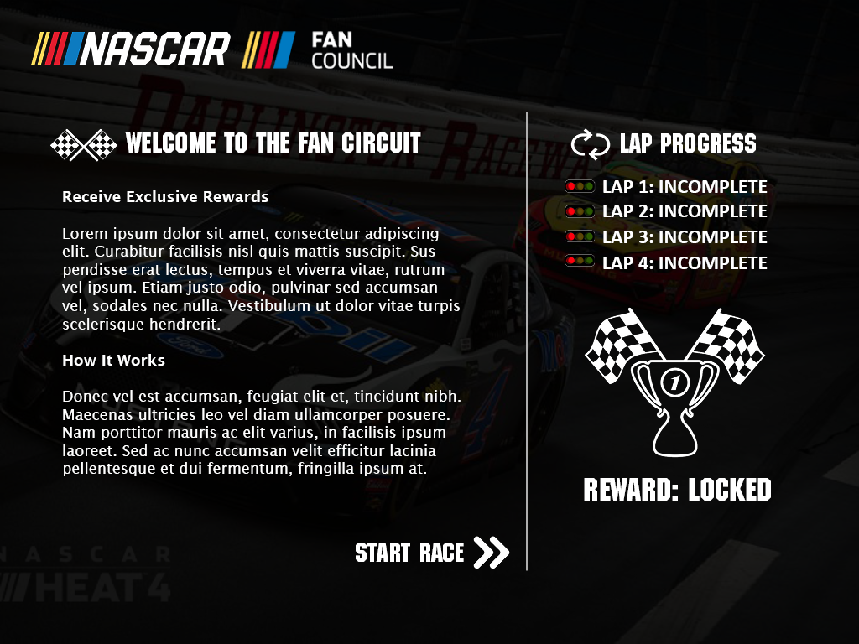
NASCAR Fan Council POC Survey
Gamified experience walks the fan through the process.
Tracks Progress
Reward Status
Starts Process

Slide 6
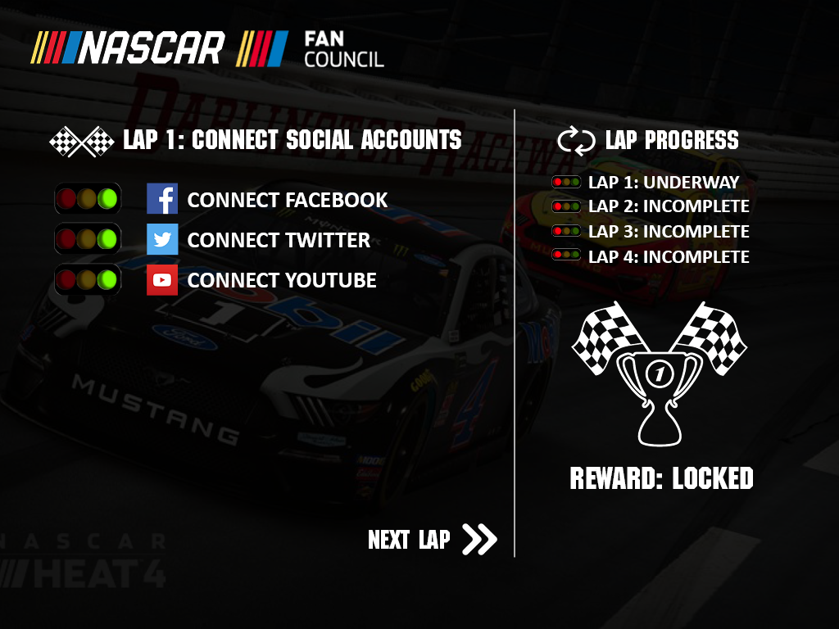
Connecting Social Media Accounts
Logging in provides API level access to fan’s social media accounts and sets them up for the data download/upload process.
Stoplight status indicator shows if the fan has connected their account successfully.

Slide 7
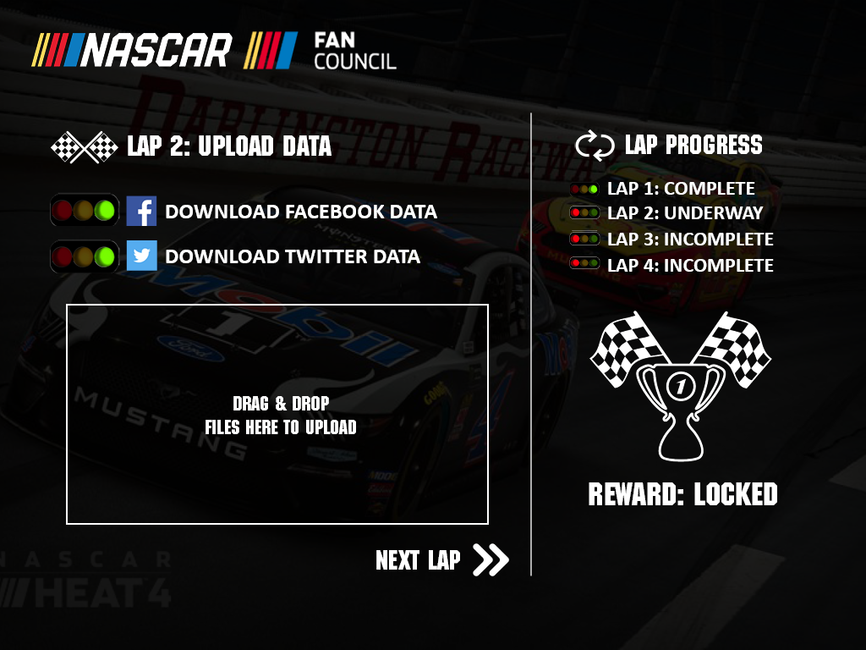
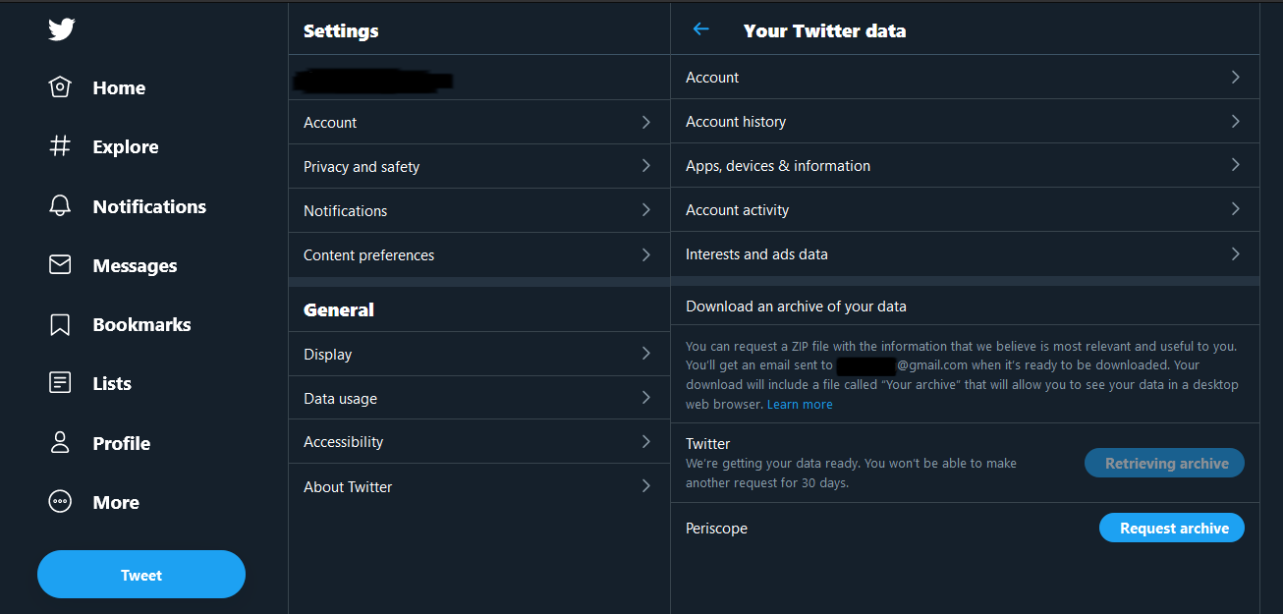
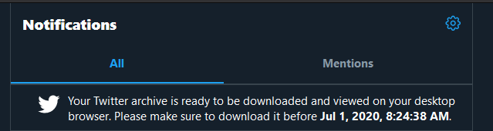
Data Upload & Download
Fans are provided a direct link to the location where they can download their data. The fan has logged into these accounts in the previous step, making this step smoother.
Fans drag their data files into the box and the upload process verifies the file.

Slide 8
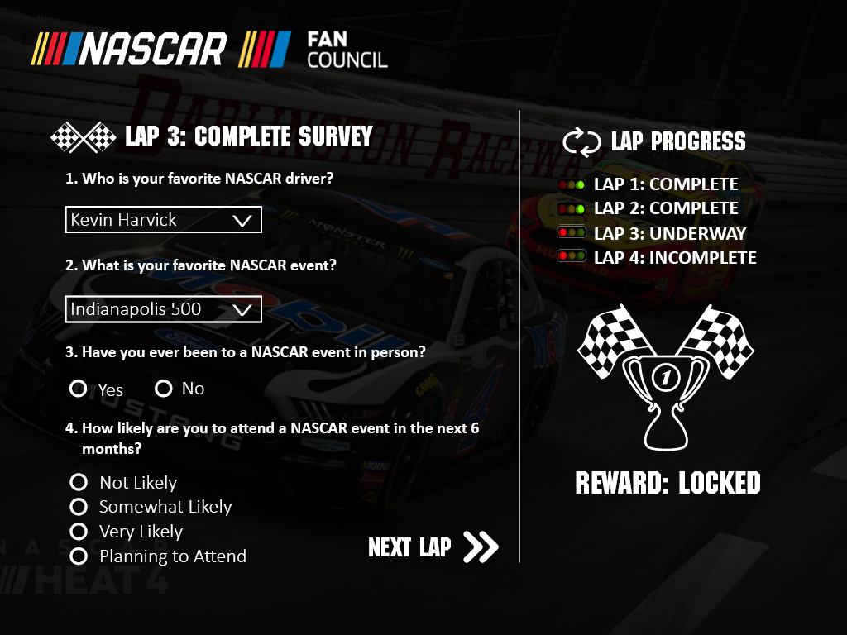
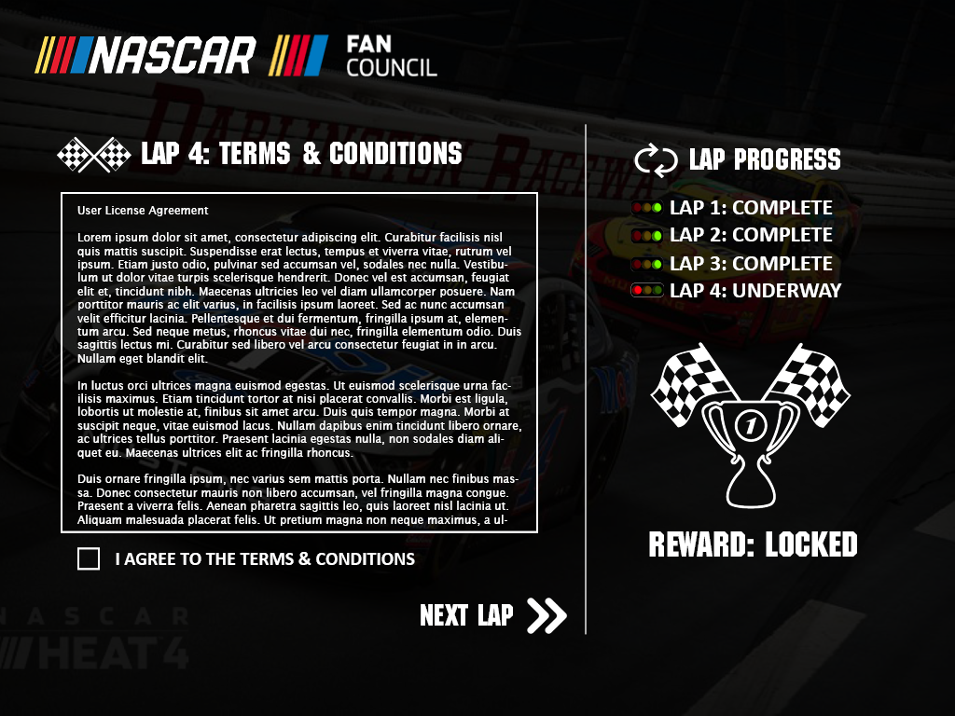
Surveys & License Agreement

Slide 9
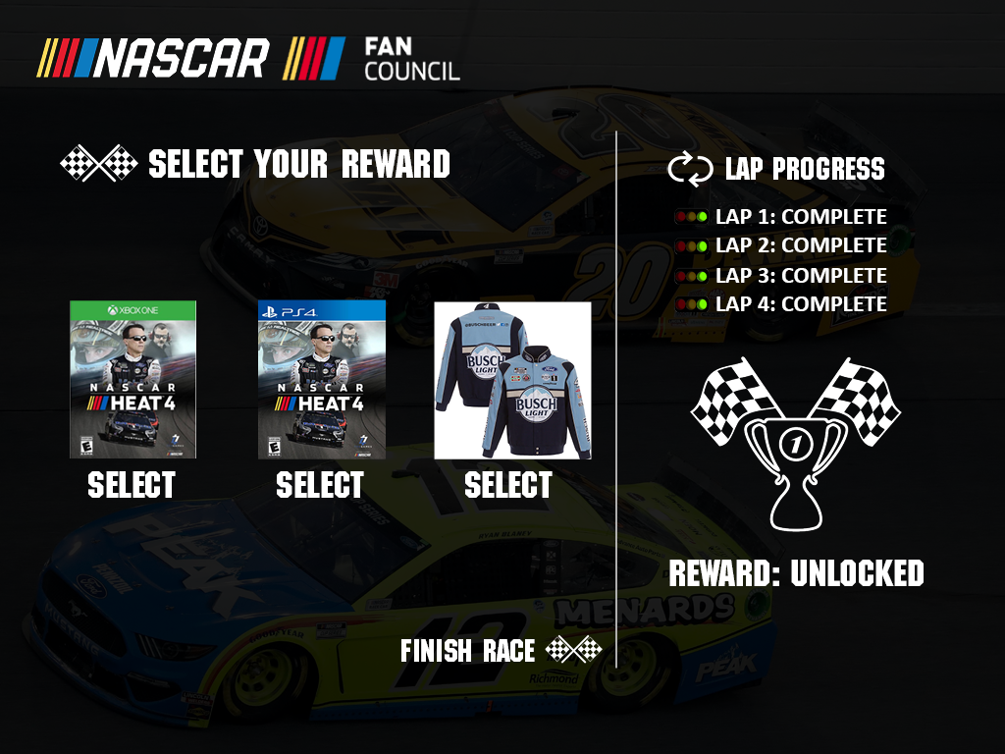
Reward Selection
After the process is finished, the reward is unlocked and the fan receives a reward of their choice.

Slide 10
Thank You
Brad Davis
CEO and Co-Founder
Brad@DataLucent.com
919.357.5345

